Slide 1
MySpace The Momentum Effect
Budapest, April 2009
Notes:
1

Slide 2
Agenda
Social Media And Where It’s Going
How People Use Social Networks
Welcome To MySpace
How MySpace Works
Brand Communities

Slide 3
Social Media And Where It’s Going

Slide 4
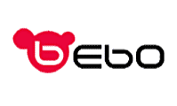
Market Trends: Social Networkers Are Connected
263 sites engage 130.1 million unique users each month
Social networking recently exceeded search as most popular online activity*
Social-networking sites reach 69 percent of the total online audience
76% of all 18-34 year olds used a social network in the past month
17 visits per person, per month
28.9 billion minutes (3.7 hours per person, per month)
65 billion page views

Slide 5
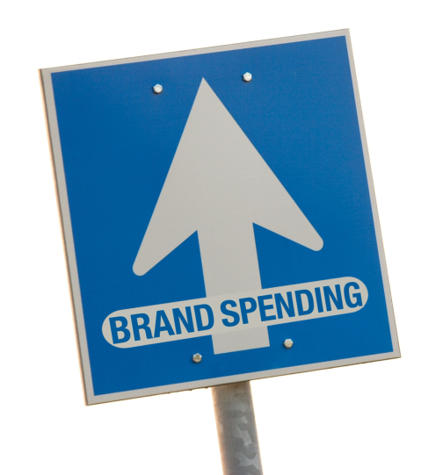
Market Trends: Brand Spending Is Increasing
48 percent of brand marketers said they planned to use social-networking and user-generated-content marketing tactics in the coming year
66 percent of fastest-growing private companies said social media is a somewhat or very important part of their business and marketing strategy
Advertisers are expected to spend $2.5 billion on social-networking sites by 2011, up from $350 million in 2006
Social networking gains share of the online spend and is projected to increase to 6.9% by 2011, up from 2.1% in 2006

Slide 6
How People Use Social Networks

Slide 7
Social Networking Is A Favorite Pastime
If you had 15 minutes of free time…
17% social networking
17% talk on cell
14% watch TV
10% surf the internet
9% play console video games
8% IM
7% listen to MP3 player
1% listen to the radio
Notes:
7
7
Let’s go back to how social networking is profoundly altering the media landscape
70% of 15-34s are on social networking sites!
Keeping in mind that young people don’t actually have a lot of free time and that what they have is quite precious, we asked users how they’d spend 15 free minutes of time
Social networking so important that it tops their preferred use of free time… on par with the their holy grail, cell phones
Look at this: what’s the coolest thing in youth life? An iPod for their music — and it’s way down the list; social networking is twice as popular as console video games and MP3 players
I spend all my time with teens and 20-somethings, and I had no idea it was going to be this big
But, it does make sense: we heard sites like MySpace described as serving as their default communication method… easy to send out a bulletin blast of news, to coordinate plans via IM; much more likely to check for messages on SN sites than over email; many leave profiles open in the background just to listen to their music
Think about how profound this shift is in their media landscape: social networking edges out TV and is on par with the cell phone; it’s remarkable.

Slide 8
Social Networking Alters The Media Mix
Weekly hours spent…
11
Going online
8.7
9.4
Watching TV
11.5
Talking on cell phone
5.1
4.6
Listening to MP3s
4.8
Social Networkers are more engaged
3.6
Reading magazines
2.7
3.2
SN users
Playing console games
2.5
Non-SN users
2

Slide 9
Users Are Constantly Engaged, Especially In Prime Time
When they’re regularly on social-networking sites…
15% first thing in the morning
16% before school/work
18% lunch
25% at school/work
31% after school/work
68% evening (PRIME TIME)
30% late night (10pm-4am)
Notes:
9
Social networking isn’t just adjusting their media landscape
It’s also having a profound impact on their media day
Users excitedly describe that they’re always on SN sites….
Demands constant updating and participation, and there’s a sense of neglect and missed opportunity when they’re not staying current with their MySpace profile.
Breakups require an almost immediate change in “relationship status” on MySpace; also, friendship status can be quickly updated by changing your “Top 8” (or whatever number of featured friends).
On MySpace, users sense that anything can happen at any time. It can happen to you…or you can make it happen! “Drama” is always just around the corner
Qual anecdotes:
- Must check site first thing in the morning when waking up
“virtual lunch” — eating at desk, MySpace-ing with friends over IM
Transition: Sean’s over-the-desk sign

Slide 10
Brand Relationships
Reasons for having brands as friends…
46% believe social networks keep them on top of trends and what’s new
40% discover brands and products they really like
29% notices of events, sales or exclusive offerings
28% recommended by a friend
23% want to associate with them
23% discounts, coupons, free samples
11% want to support them
Notes:
10
10
Asked why they’d want a brand as a friend, most immediately mentioned the practical: free stuff; who doesn’t want free stuff?
But, importantly, and as Don will cover in the next portion of this presentation, the real news is that it’s about engaging beyond the discount
It’s increasingly about affiliation — not just getting free stuff, but wanting to support a brand or company you care about, to associate yourself with them to benefit from their halo and to publicly align yourself with them

Slide 11
Welcome To MySpace

Slide 12
Welcome To MySpace
Reaching 120 million people worldwide³
In Hungary more than 200.000 people are actively using MySpace genrating over 20 Million page views.
The premier social destination
MySpace visitors spend nearly 17.2B minutes on the site every month
They view 40.3B pages

Slide 13
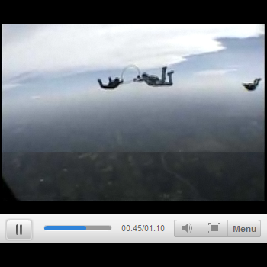
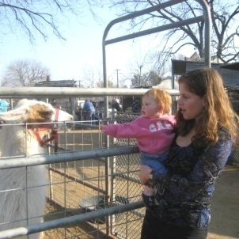
The MySpace Platform
DISCOVERY
CONNECTION
SELF-EXPRESSION

Slide 14
Re-defining MySpace: The Social Portal
More than just a social network.
More than just a gateway to content.
MySpace is a global lifestyle brand that connects people, content and culture.
music
movies
videos
games
mail
IM
Social Portal = Social Network Portal
Notes:
MySpace is not an experiment of “social media”
Brands are spending “portal dollars” on MySpace
State of the market gives us an advantage
More traffic and relevance than any portal
MySpace is going through a Renaissance:
Global redesign
MySpace Music JV
Emerging as a global lifestyle brand

Slide 15
How MySpace Works

Slide 16
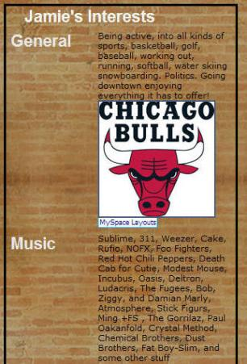
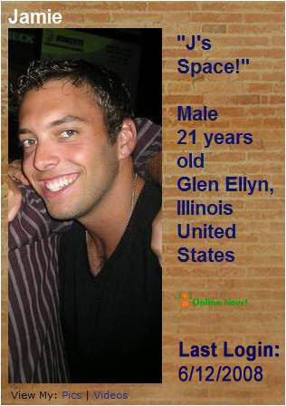
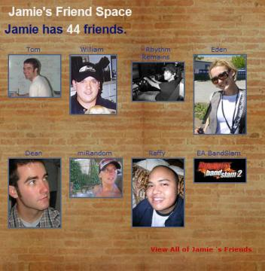
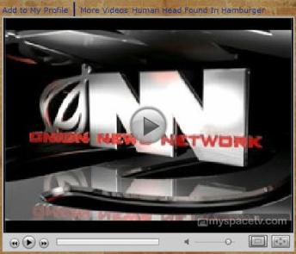
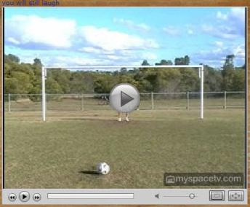
The Profile Is The Core

Slide 17
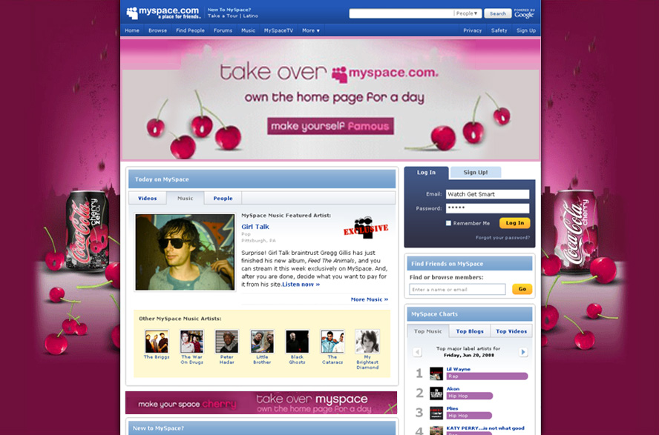
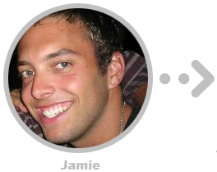
How The Momentum Effect Works: Jamie Is Engaged By An Ad…
Notes:
17

Slide 18
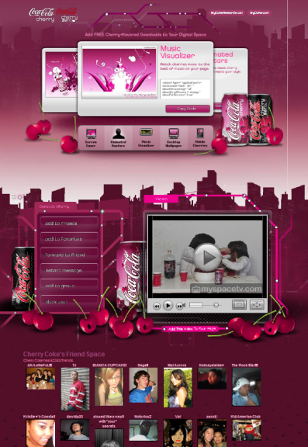
Jamie Visits Brand Community…

Slide 19
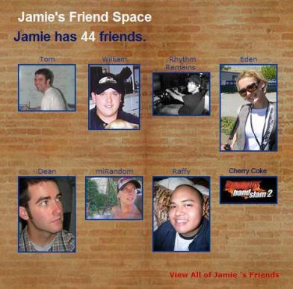
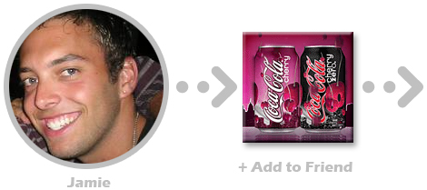
Jamie Adds Brand As Friend…
Notes:
19

Slide 20
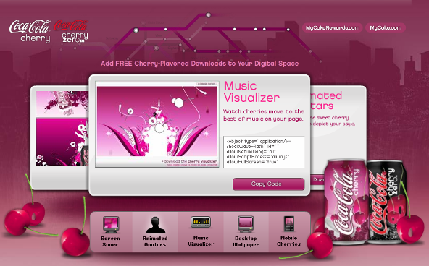
Jamie Interacts With Brand Community…
Notes:
20

Slide 21
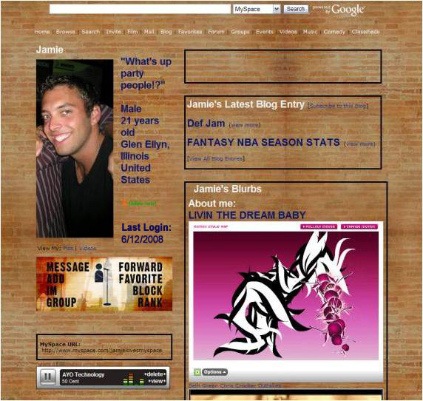
Jamie Adds Branded Elements To His Profile…
Notes:
21

Slide 22
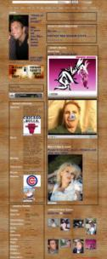
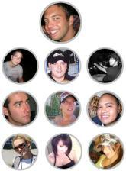
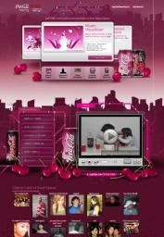
Jamie’s Friends Interact With Brand And Pass Along To Their Friends…
Notes:
22

Slide 23
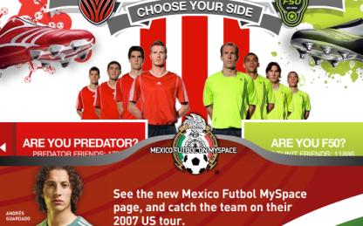
The Momentum Effect In Action: Smart Media + Brand Community = Momentum
44,000
MySpace Campaign: Adidas
Results: Momentum-Driven ROI*
thousands
"Definitely Will Purchase"
ROI: Extraordinary
450
400
350
300
20X
250
People Impacted Per $100,000 Spent
200
150
3X
100
50
0
Adidas launched an integrated campaign to introduce two new brands of shoes
The campaign included an interactive brand community where users could choose a team
Also included standard media to drive traffic to the community
Online Advertising
MySpace Advertising
PLUS Momentum Effect
Momentum Effect
Advertising Effect
Notes:
Here’s how we tracked the actual momentum effect of the Adidas execution.
Adidas runs ads that link to their MySpace Custom Community.
609,182 people visited the community as a result of the ads
Of these 609,182, 74,455 viewed or downloaded one of the brand experiences and 63,230 put one of the Adidas skins, badges, or videos on their MySpace page.
37,511 people then passed along an element to their friends
35,00 people received this element and the cycle begins again; some passed along these elements to their friends, some visited the custom community, some viewed downloads there, and some put more elements on their pages.
And that’s the momentum effect. Long after the initial ad impressions ran on the site members and their friends are still interacting with the Adidas brand. In total 21.5MM extra impressions were generated by the momentum effect
So this is great. Who wouldn’t want bonus impressions, right? But the real question is what is the impact of these Momentum impressions? Adidas sent out with a clear goal to drive purchase intent. Do the Momentum Effect accomplish this goal?

Slide 24
Brand Communities

Slide 25
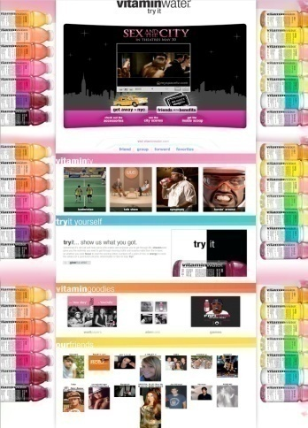
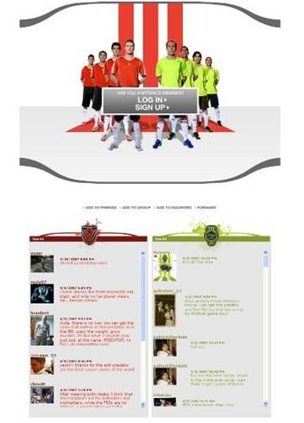
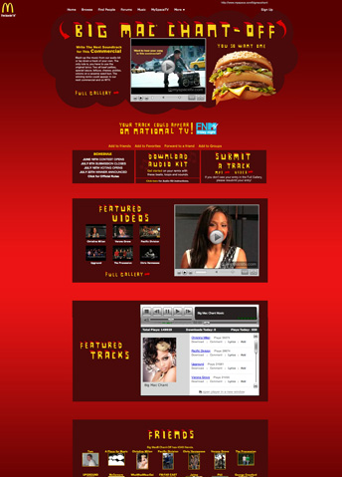
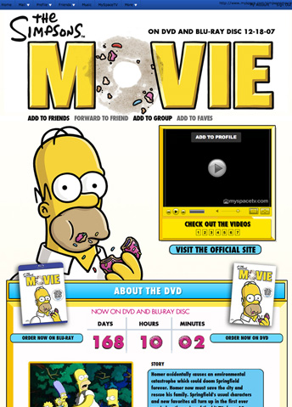
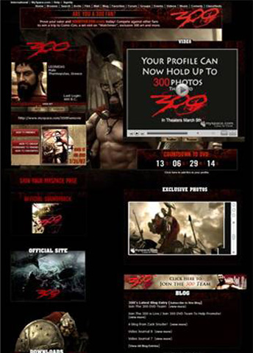
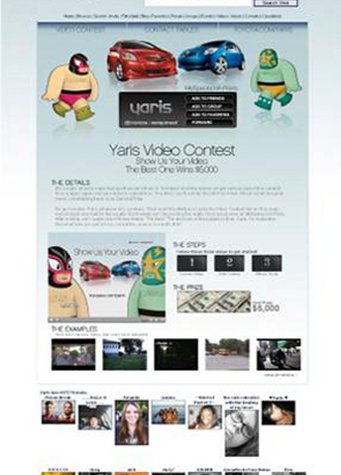
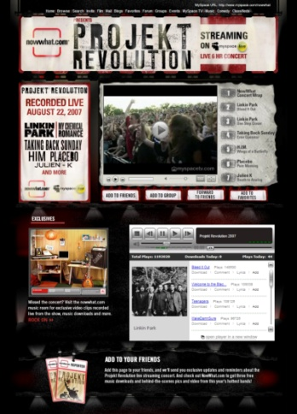
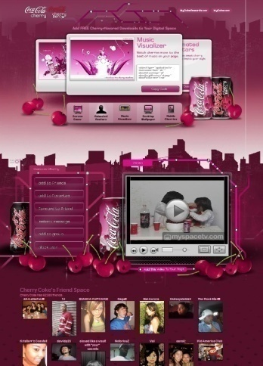
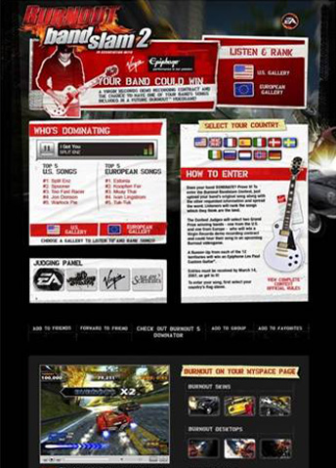
The Most Engaging Advertising Platform
Click on a community icon to view a larger image
Notes:
25
25

Slide 26
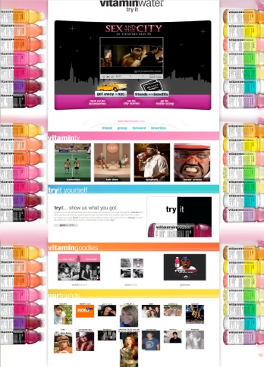
The Most Engaging Advertising Platform
Just Got Even Better…
Click anywhere to return to communities home screen
Notes:
26
26

Slide 27
The Most Engaging Advertising Platform
Just Got Even Better…
Click anywhere to return to communities home screen
Notes:
27
27

Slide 28
The Most Engaging Advertising Platform
Just Got Even Better…
Click anywhere to return to communities home screen
Notes:
28
28

Slide 29
The Most Engaging Advertising Platform
Just Got Even Better…
Click anywhere to return to communities home screen
Notes:
29
29

Slide 30
The Most Engaging Advertising Platform
Just Got Even Better…
Click anywhere to return to communities home screen
Notes:
30
30

Slide 31
The Most Engaging Advertising Platform
Just Got Even Better…
Click anywhere to return to communities home screen
Notes:
31
31

Slide 32
The Most Engaging Advertising Platform
Just Got Even Better…
Click anywhere to return to communities home screen
Notes:
32
32

Slide 33
The Most Engaging Advertising Platform
Just Got Even Better…
Click anywhere to return to communities home screen
Notes:
33
33

Slide 34
The Most Engaging Advertising Platform
Just Got Even Better…
Click anywhere to return to communities home screen
Notes:
34
34

Slide 35
The Most Engaging Advertising Platform
Just Got Even Better…
Click anywhere to return to communities home screen
Notes:
35
35

Slide 36
Brand Communities: Build A Lasting Relationship With Consumers
Create A Community
Build a brand destination within the MySpace ecosystem
Build relationships with consumers by providing interesting, relevant and entertaining content
Give consumers a reason to talk about your brand to activate momentum
Cultivate Relationships
Monitor community and listen to your consumers
Update community with fresh, engaging content
Message your brand advocates to alert to new content
Build Long-Term CRM
Increase breadth, depth and longevity of consumer relationships
Develop messaging strategy and frequency
Gain insight from product feedback and audience’s behavior
Community launch
Strengthen consumer relationships
Long-term partner

Slide 37
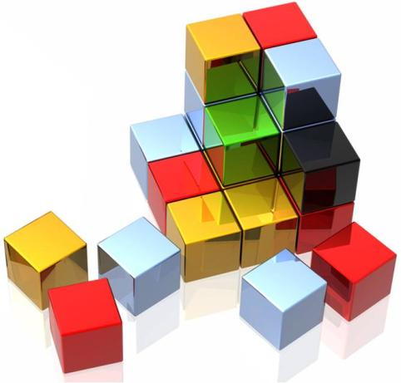
How To Build A Successful Community
Keep it simple
Too much clutter/multiple items competing for users’ attention have a detrimental effect on time spent and click through metrics
Focus on the objectives
Keep all key interactions that support campaign objectives above the fold
Exclusive content is king
Exclusive videos, badges and widgets are more likely to be embedded by users and passed along to their friends
Be media-minded
Without the support of media or events, traffic levels on communities quickly taper off
Stay fresh
Release of new branded assets (badges, wallpapers, video, etc.) over time entices return visits and pass-along to friends
Foster friendly competition
Finalists promote their entries and the contest to their friends for support
Voting on contest finalists and seeing the results drive return visits

Slide 38
Thank You

